Slide 1
Computational Skills for Informatics Workshop Series Galter Health Sciences Library
Intro to the Command Line
(with some genomics examples)
https://github.com/galterdatalab/commandline_genomics/
Pamela Shaw (Galter): p-shaw2@northwestern.edu
Slides courtesy of:
Janna Nugent: janna.nugent@northwestern.edu
With additional help from:
Dusan Ramljak dusan@northwestern.edu
Alper Kinaci: akinaci@northwestern.edu
Christina Maimone: christina.maimone@northwestern.edu

Slide 2
Set up (if you haven’t already)
https://github.com/galterdatalab/commandline_genomics/
Click the green “Clone or download” button
Click ”Download ZIP”
Unzip the file to your computer’s desktop

Slide 3

Designed for ease of use:

Slide 4
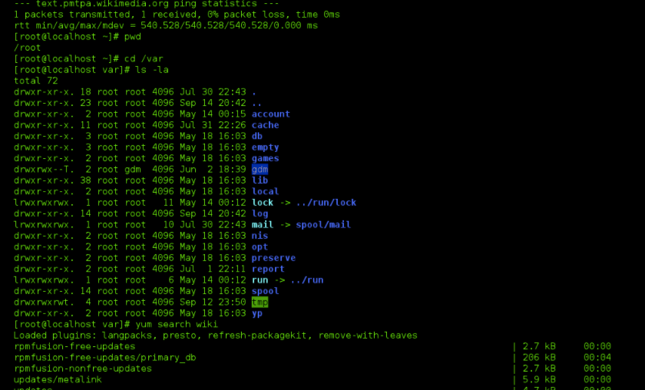

Designed for power
NOT
Designed for ease of use:

Slide 5
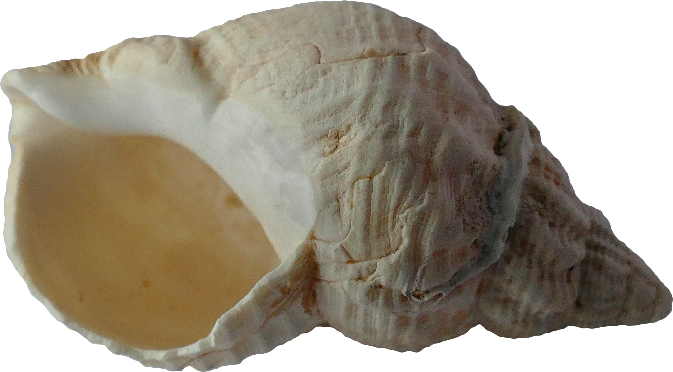
Introducing the Shell Why use it?
Hello, shell!
What do I do with this?
Photo by Anthony from Pexels

Slide 6
Why use the shell?
Many bioinformatics tools can only be used through a command line interface, or have extra capabilities in the command line version that are not available in the GUI.
The shell makes your work less boring. In bioinformatics you often need to do the same set of tasks with a large number of files. Learning the shell will allow you to automate those repetitive tasks and leave you free to do more exciting things.
Automating these repetitive tasks also reduces your chance of introducing errors to your workflow.
The shell makes your work more reproducible. When you carry out your work in the command-line (rather than a GUI), your computer keeps a record of every step that you’ve carried out, which you can use to re-do your work when you need to. It also gives you a way to communicate unambiguously what you’ve done, so that others can check your work or apply your process to new data.
Many bioinformatic tasks require large amounts of computing power and can’t realistically be run on your own machine. These tasks are best performed using HPC systems (Quest) or cloud computing, which may be accessed only through a shell.
- Adapted from the Data Carpentry Genomics Introduction to the Command Line lesson

Slide 7
Finder on my Mac

Slide 8
looking around at files in Unix

Slide 9

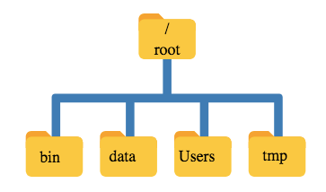

Slide 10


“Root”
a location: the base of the filesystem tree
/
a user: the superuser

Slide 11
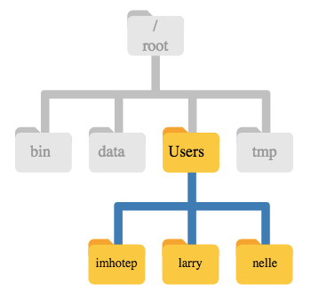

Root ≠ Home
/ ~
This is Nelle’s home directory

Slide 12
Finder on my Mac

Slide 13
Getting Started
Launch your command line program
Type pwd, hit return
http://www.computerhh.co.uk/beginner.html
Notes:
Where are you? Most likely you are in your “home” directory. Type ls to see a list of files and directories. If you see “Desktop”, type cd Desktop. Now type cd commandline_genomics_master. Type ls again to see what’s here. Now type cd shell_data.

Slide 14
Some commands
pwd ”print working directory”
cd <directory name> “change directory”
typing cd with nothing after it will take you to your home directory ( ~ )
ls “list directory contents”
Each of these commands accepts arguments, which are preceded by a -
man <command> gives you the manual for a bash command
Hit space key to move forward in the manual, b to move back, and q to exit the manual
Notes:
Let’s add the flag ls –F to ls command to see whether the contents of a directory are files or other directories. This is called a “flag”. you can find out about arguments for ls, you can look it up in the manual. type man ls.

Slide 15
Notes:
We’re in the shell_data directory, so let’s type ls –l. We see the owner and permissions for the file. We’ll talk about permissions in a later lesson. Now let’s cd into untrimmed_fastq by using tab completion. type cd untr<tab>

Slide 16
Tab completion
Use the tab key to auto-complete a file or directory name, or even commands
Saves time
Avoids spelling or typing errors
But: Only auto-completes unique words
For entries that have similar names, you can hit tab again
Works for program names, too
Notes:
Now that we’re in the untrimmed_fastq directory, if we try to type ls SR<tab> we only see SRR09 because both files start with that. Hit tab twice to see both files listed.

Slide 18

Navigating Files & Directories
Photo by aitoff from Pixabay

Slide 19
Navigational shortcuts
Use .. (two dots) to move up one level
You can string them together
eg. ls ../../ shows the contents of two levels above your current working directory
The tilde ~ is your home directory
The / is your root directory (we’ve already seen that)
Notes:
First, pwd to see where you are. Now navigate to your command_line_genomics_master. Now type ls data_shell. you can see the contents of that directory without moving to it. Similarly, if you want to move directly to another folder below the current one, just type cd and the path: eg. cd shell_data/sra_metadata (don’t forget tab complete can help you)

Slide 20
Finding hidden directories and files
Hint: try using man ls to look up the argument you need for ls to find hidden objects
Notes:
man ls
ls –a
cd .hidden
ls

Slide 21
Absolute vs relative paths
This is the full file path to the commandline_genomics_master directory on my Mac:
I can see it by typing pwd while in commandline_genomics_master
/Users/pls360/Desktop/commandline_genomics-master
Notes:
I can type the whole path in to get to shell_data, but if I’m already in commandline_genomics_master, I don’t have to. I just type cd shell_data. This is a relative path (relative to where I am now)

Slide 22
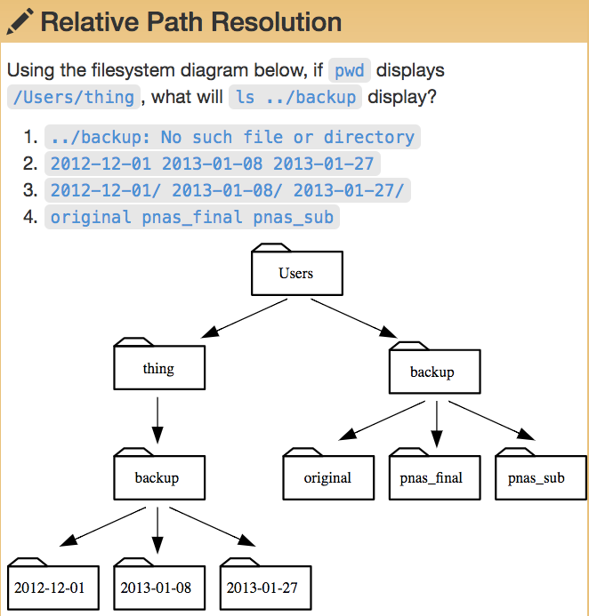

Slide 23
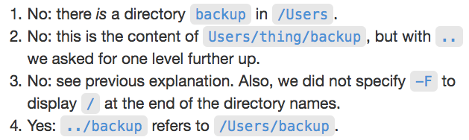
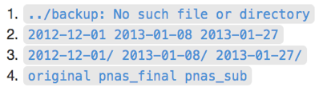

Slide 24
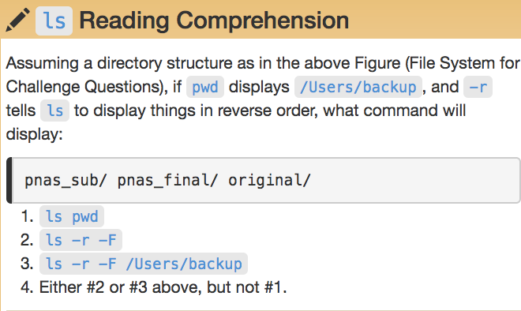
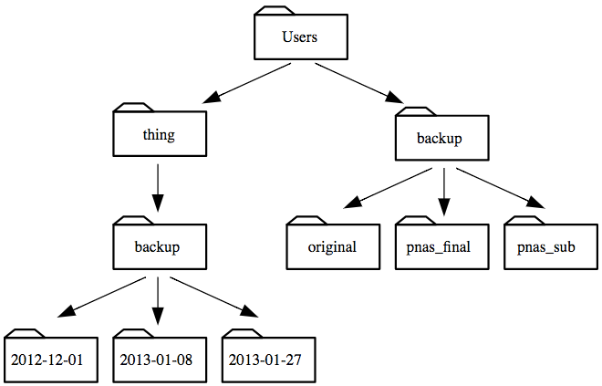

Slide 27
Working With Files & Directories

Slide 28
Wildcards

Slide 29
Wildcards
Navigate to the untrimmed_fastq directory
You can find all the fastq files by using a wildcard *
ls *.fastq
You can use wildcards to find programs, too
ls /usr/bin/*.sh

Slide 30
Wildcards
* matches 0 or more characters
? matches only one character
[ ] matches a single occurrence of any of the characters typed in the brackets
eg. l[aeio]st.sh would find last.sh, lest.sh, list.sh and lost.sh (if they all existed in the directory)

Slide 31
Some notes about the root directory (/)

Slide 35
Command History
Use the up arrow to go back one command in your history (until you hit the earliest command)
Use the down arrow to go forward in your history (until you hit the last command)
Control c will cancel the current command and give you a new prompt
Control r will let you do a reverse search in your commands (very useful)
Control l or clear will clear your screen

Slide 36
Command History
Use history to get the history of your commands (over several sessions)
You get a numbered list of your commands
Type !<command number> to rerun a specific command

Slide 37

Examining Files
Photo by Pixabay from Pexels

Slide 38
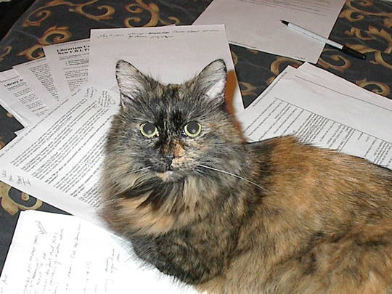
Examining Files
Use cat <filename> to view/read the contents of a file
Cat reads file
Exercise:
From your home directory, and without changing directories, use one short command to print the contents of all of the files in the /shell_data/untrimmed_fastq directory.
Notes:
Start in your untrimmed_fastq directory. type cat SRR098026.fastq.
solution:
cd ~
cat ~/Desktop/commandline_genomics-master/shell_data/untrimmed_fastq/*.fastq
(may be different on different computers)

Slide 39
Examining Files
cat prints out the whole file
use less <filename> to open the file as read-only and navigate through it

Slide 40
Examining Files
less also lets you search the file
while in less, type / then the sequence you’re looking for
Shortcuts:
To search forward in less, type / and return to get the next occurrence
To search backwards, type ? and return to get the previous occurrence
Notes:
Navigate back to the untrimmed_fastq directory:
cd Desktop/commandline_genomics-master/shell_datal/untrimmed_fastq/
Try less SRR097977.fastq. Then type /TTTTT. Type /return to see the next occurrence, or ?return to see previous
q to quit

Slide 41
Head and tail
Examining Files
head <filename> lets you see the first 10 lines of a file
tail <filename> lets you see the last 10 lines of a file
You can add -n to head or tail to specify the number of lines you want to see
Notes:
Try head SRR097977.fastq. Then try tail. Then try head –n 4 SRR098026.fastq. Same for tail.

Slide 42
Quick FASTQ file format reminder
Line 1 begins with a '@' character and is followed by a sequence identifier and an optional description (like a FASTA title line).
Line 2 is the raw sequence letters.
Line 3 begins with a '+' character and is optionally followed by the same sequence identifier (and any description) again.
Line 4 encodes the quality values for the sequence in Line 2, and must contain the same number of symbols as letters in the sequence.

Slide 43
Quick FASTQ file format reminder

Slide 44
Creating, Moving, Copying and Removing Files

Slide 45

Copying Files
Photo by aitoff from Pixabay

Slide 46
Copying Files
cp <filename> <new_filename>
try this with SRR098026.fastq in the shell_data/untrimmed_fastq directory, and call it SR098026-copy.fastq
then list the files
Notes:
It’s always a good idea to save the original data, so making a backup copy is one way to ensure that the original stays as it is.
cp SRR098026.fastq SRR098026-copy.fastq
ls

Slide 47

Creating Directories
Nope, not this easy
Photo by www_slon_pics from Pixabay

Slide 48
Creating Directories
mkdir <filename> creates a directory with the name you choose
try mkdir backup
Notes:
mkdir backup

Slide 49
Moving / Renaming
Notes:
mkdir backup

Slide 50
Moving / Renaming
mv <filename> <directory> will move a file to a different directory
mv is also the command for renaming files (without copying)
mv <filename> <new_filename>
Notes:
mv SRR098026-copy.fastq backup
ls backup
cd backup
mv SRR098026-copy.fastq SRR098026-backup.fastq
ls

Slide 51
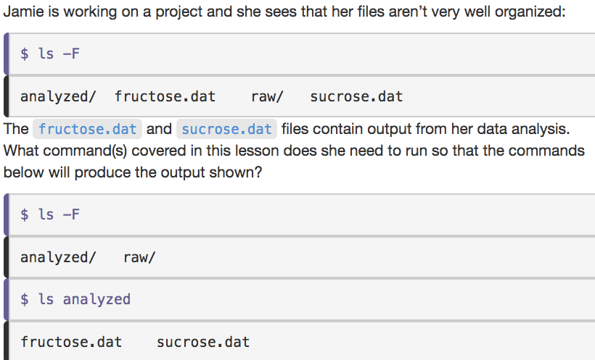


Slide 52
File Permissions

Slide 53
File Permissions
Notes:
Just because we created the backup doesn’t mean it’s safe from modifications, unless we protect it.
Make sure you’re in the untrimmed_fastq directory.
ls –l
shows you permissions

Slide 54
File Permissions
chmod -w <filename> will remove the “write” permission for the file
You can add or remove read, write and execute permissions, depending on your own user level permissions in the file system
Notes:
let’s chmod –w SRR098026-backup.fastq
ls -l

Slide 55

Removing

Slide 56
Removing
rm <filename> will remove the file
Note: removing a file in the shell removes it forever. There is no trash can here.
rm will not remove directories
to remove a directory and its contents, use rm -r for “recursive” removal
to have the shell ask you if it’s okay to remove the file(s), add the -i flag for “interactive” mode
Notes:
Let’s try rm SRR098026-backup.fastq. Since we’ve write-protected it, the shell will ask us if it’s okay to override file permissions.
Now let’s recursively remove the directory ”backup. Move up to the directory above (using .. from the backup directory)
rm -r backup
if we have write-protected this file, we’ll be asked if we want to remove the files in the directory

Slide 58

Writing Files
Photo by Pexels from Pixabay

Slide 59
Which command line editor?
vi/vim is the editor we’ll use today
takes some time to learn, but powerful
nano the editor used by the Carpentries lessons
easier to use than vi, but less powerful and not as flexible as vi
others
notepad in (some) Windows machines can be launched from the shell
emacs like vi takes some time to learn
if you need to write more complex scripts, you will likely use a different kind of editor such as Atom, Sublime, etc

Slide 60

text editor: nano
type “nano <filename>” this will open the named file for editing or create it if it doesn’t exist
type your text: the mouse will not move the cursor - navigate with the arrow keys
save and quit: commands are on the bottom of the screen - the “^” stands for “control”

Slide 61
text editor: vi/vim
On command line: “README.txt”
You land in command mode
To enter insert mode: “i” where the cursor is; “o” inserts one line below that
Navigate with arrow keys
To exit insert mode: “esc”
To save: “:w”
To exit: “:q”
To exit without saving: “q!”
Notes:
Lets’s start in the shell_data/untrimmed_fastq directory
vi README.txt
hit “i”
Type in some lines of text describing the files: what they contain, how many, location of backup files (if any). there’s not much to say about them right now, but in real life, we would update this readme file as we make edits.
When done, hit esc key, type :w, then :q

Slide 62
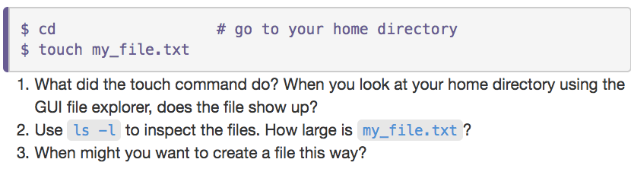
Touch: make an empty file

Slide 63

End of Part 1!!
Part 2 next week

Slide 64
Review from last week
We covered
how to move around in directories
how to access the manual for commands
absolute vs relative paths
how to use wildcards to find files
how to access the command history
how to open and read / examine files
how to create, move, rename, copy, & remove files
file permissions
how to write files with vi and create an empty file with touch

Slide 65

Redirection
Photo by Pixabay from Pexels

Slide 66
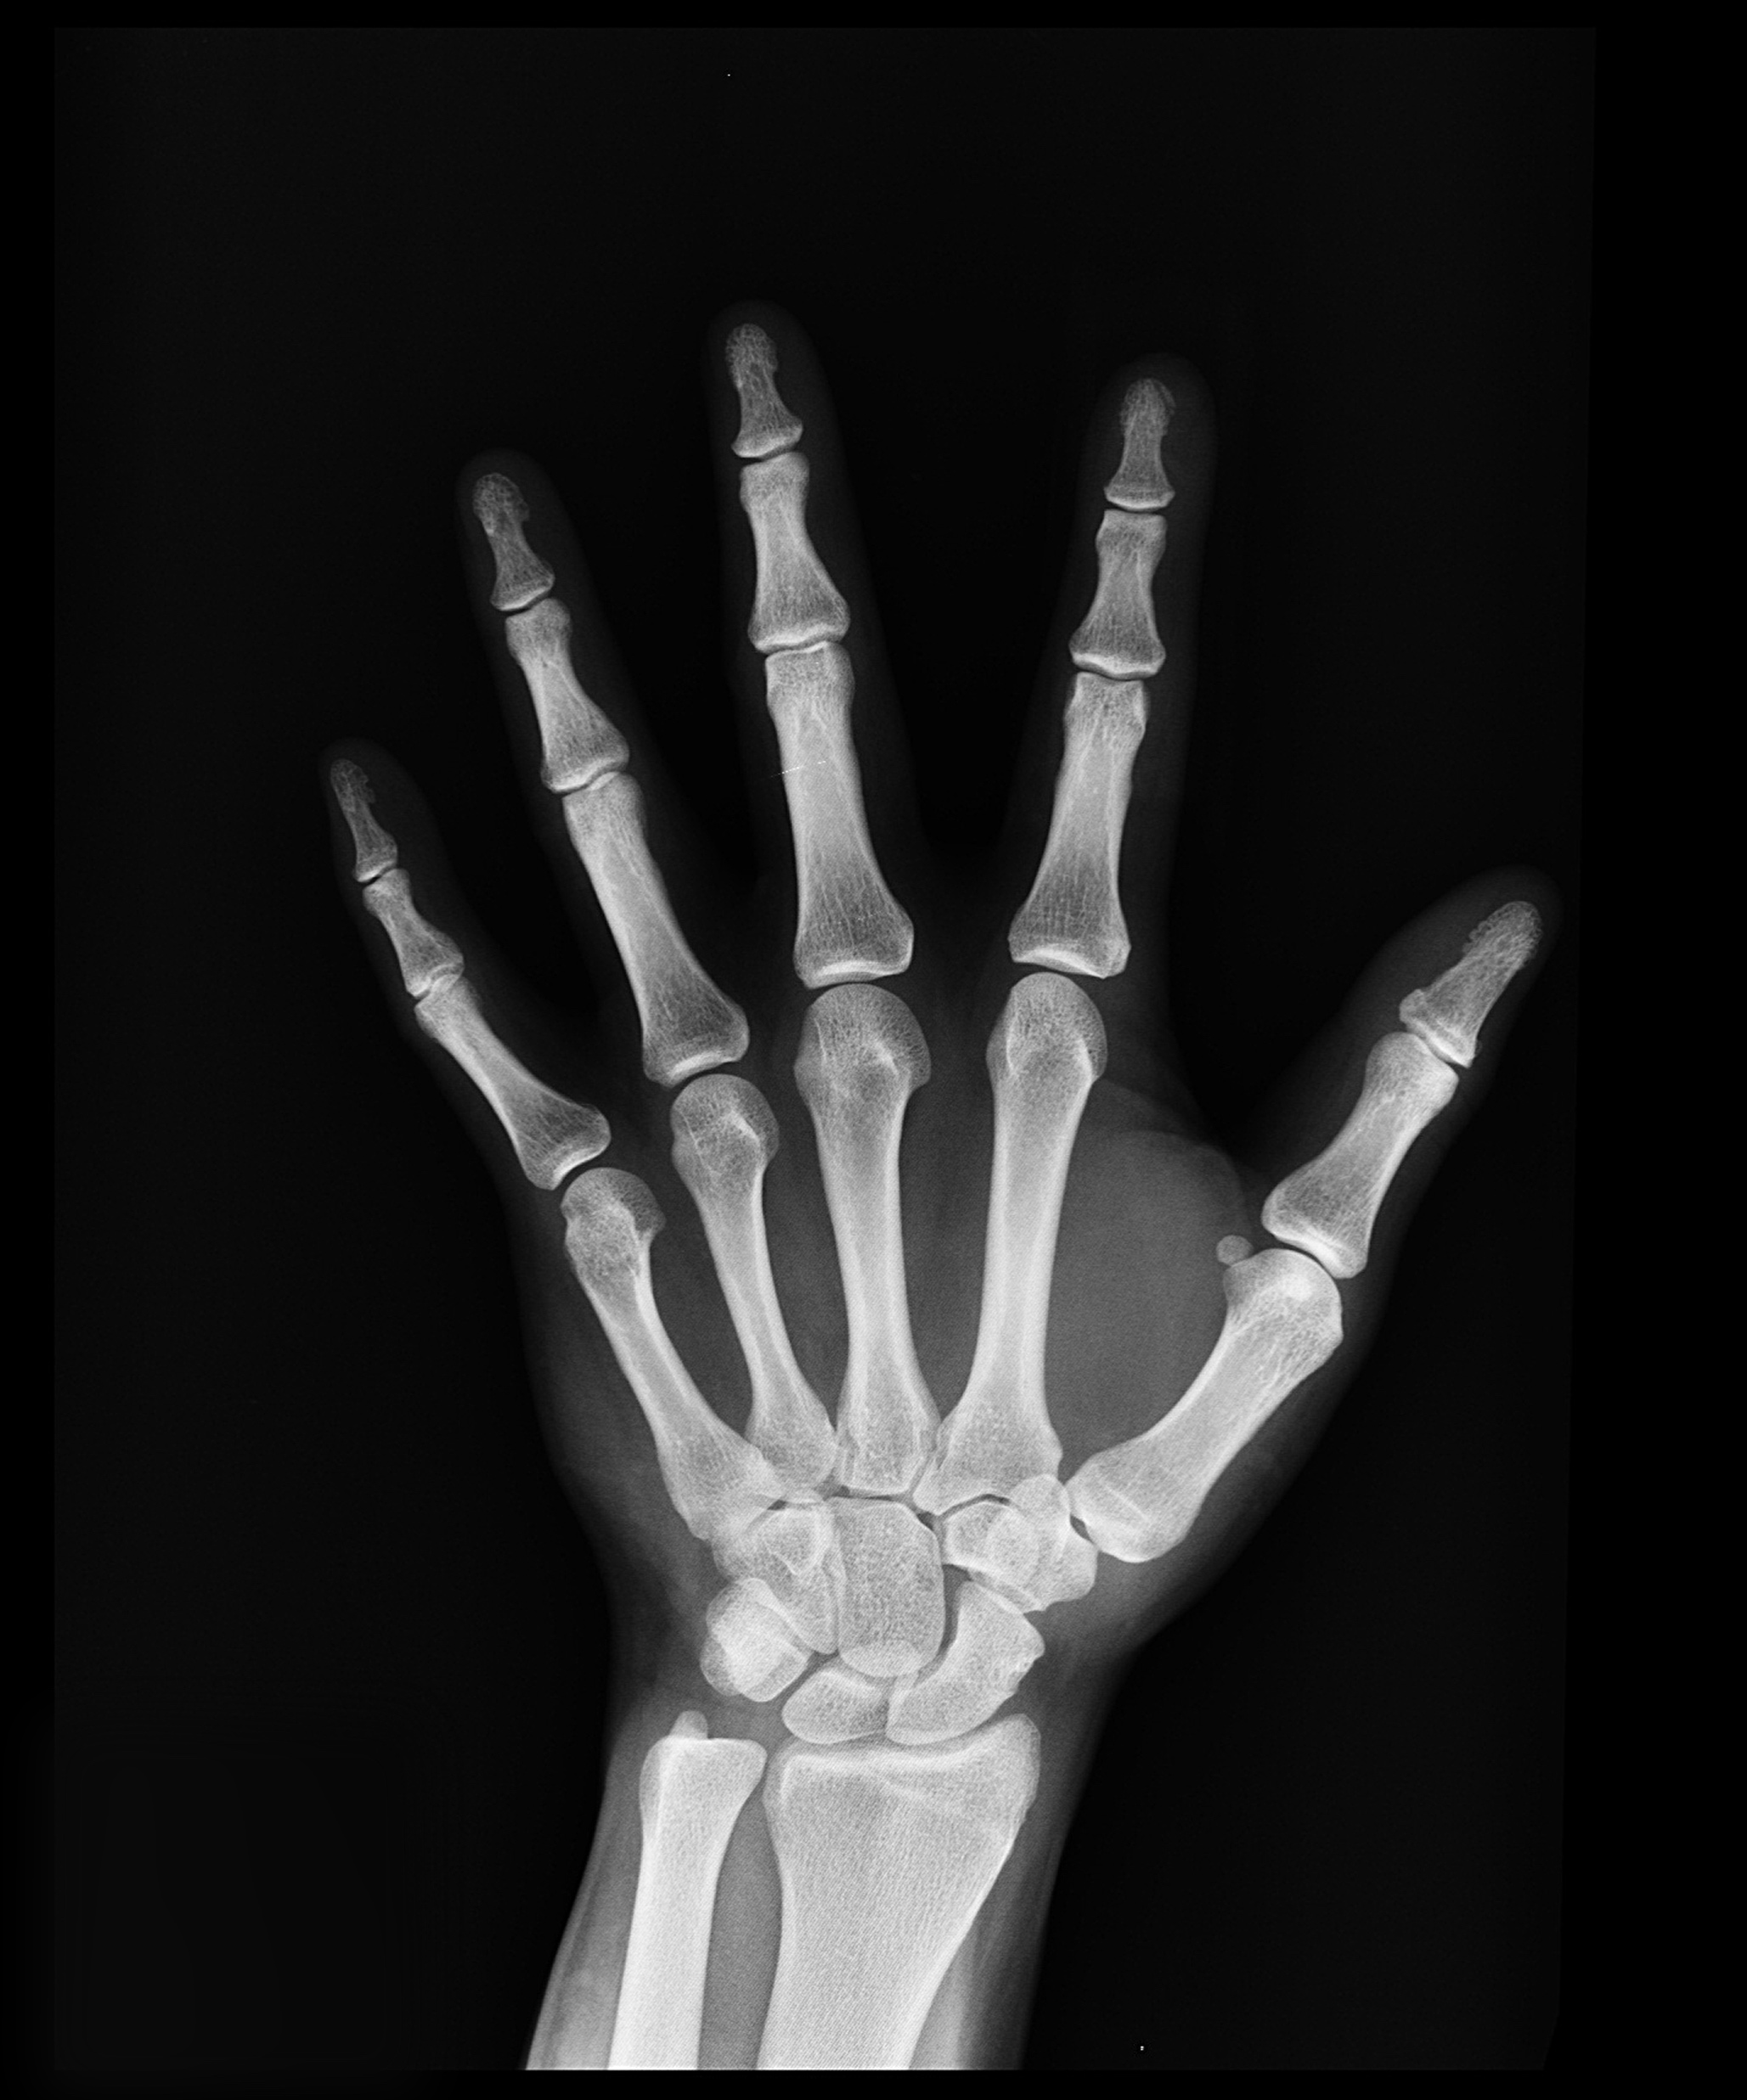
Searching within a file (without opening it)
Photo by Pixabay from Pexels

Slide 67
grep
grep <string to search> <filename> allows you to search a text file for a string without opening the file
Make sure you’re in the shell_data/untrimmed_fastq directory
we’re going to search for 10 consecutive unknown nucleotides (Ns), suggesting poor-quality reads
grep NNNNNNNNNN SRR098026.fastq
if we want the whole read, we need the line before and two lines after the nucleotide read:
grep -B1 -A2 NNNNNNNNNN SRR098026.fastq
Notes:
cd ~/Desktop/commandline_genomics-master/shell_data/untrimmed_fastq
You’re going to get a BUNCH of stuff from the grep command, but it’s all just lines of nucleotide reads with Ns. We probably want the read identifier and perhaps the quality score or other information from all 4 lines of the fastq read

Slide 68
Notes:
grep –B GNATNACCACTTCC SRR098026.fastq
grep –B1 AAGTT *.fastq

Slide 70
Redirecting output
grep sends results to your terminal screen, but you can send the results to a file for further analysis
this is called “redirection”, and uses >
eg:
grep –B1 –A2 NNNNNNNNNN SRR098026.fastq > bad_reads.txt
It may look like nothing happens, but check with ls
If you redirect to the same file again with >, the contents will be overwritten
to redirect without overwriting what’s in the file, use “append redirect” >>
Notes:
You might be confused about why we’re naming our output file with a .txt extension. After all, it will be holding FASTQ formatted data that we’re extracting from our FASTQ files. Won’t it also be a FASTQ file? The answer is, yes - it will be a FASTQ file and it would make sense to name it with a .fastq extension. However, using a .fastq extension will lead us to problems when we move to using wildcards later in this episode. We’ll point out where this becomes important.

Slide 71
Echo and append redirect

Slide 72
Word count
wc <filename> gives us a count of lines, words & characters in a file
wc –l <filename> just the lines
wc –w <filename> just the words, etc
Try it out: wc bad_reads.txt wc –l bad_reads.txt

Slide 73
Word count
Hint: start by finding all the sequence lines with at least 3 Ns and write them to bad_reads.txt (overwrite the file)
Notes:
Lets take all the sequence lines with at least 3 consecutive Ns and write them to bad_reads.txt (overwrite)
grep NNN SRR098026.fastq > bad_reads.txt
wc –l bad_reads.txt

Slide 74

Pipes & Filters
Photo by Tim Mossholder from Pexels

Slide 75
Pipes
Pipes let you string together multiple bash commands in a single line of code
This saves you from creating intermediate files that you don’t want later (keeps your directories cleaner)
Try it: grep -B1 -A2 NNNNNNNNNN SRR098026.fastq | wc -l
Notes:
Remember how we sent our reads with 10 Ns or more to bad_reads.txt, then we did a wc –l on them. We don’t have to create the bad_reads file if all we want is the number of bad reads.

Slide 76
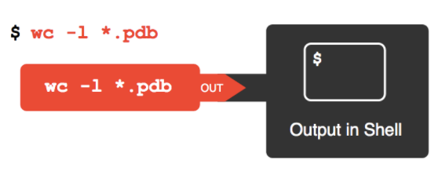
Notes:
I have some more data files for you to work with
go up to the shell_data directory, then into molecules:
cd ../molecules
Now execute the command on the screen

Slide 77
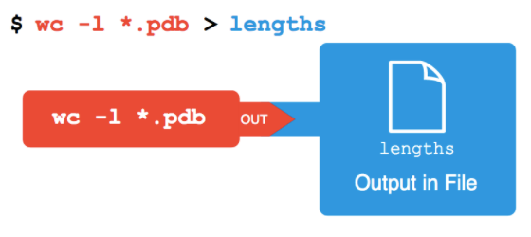
Notes:
Do the same command (hit the up arrow on your keyboard), then add > lengths.txt

Slide 78
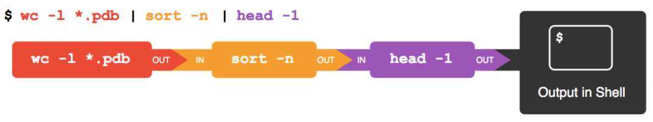
Notes:
Now try these commands. Do just the first 2 first so you can see what sort did. then hit the up arrow and add the third pipe. Sort and wc are called “filters”.

Slide 79
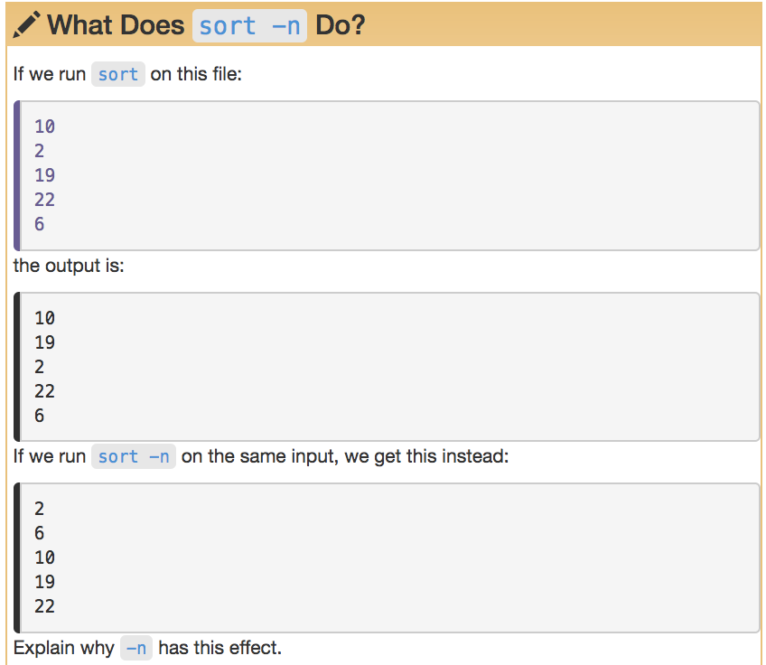

Slide 80
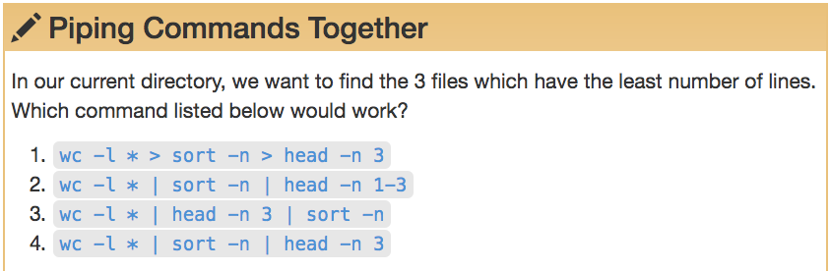
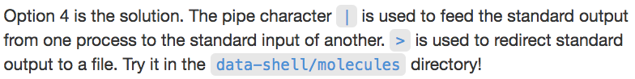
Notes:
Make sure you’re still in Molecules directory.

Slide 81
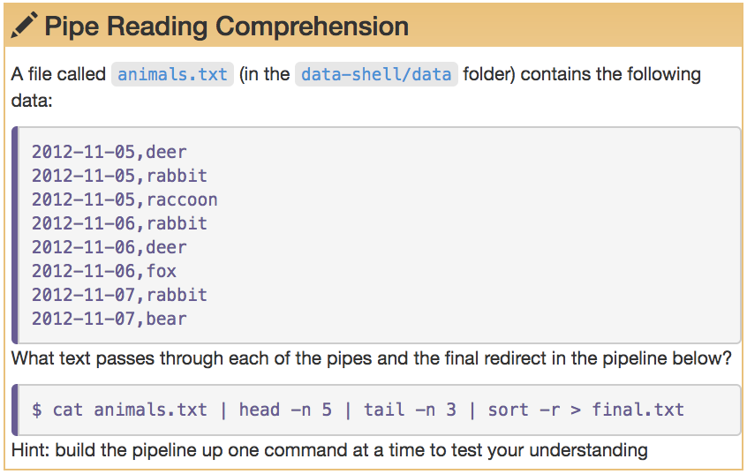
shell_data/data/
Notes:
If you’re still in Molecules, to into /data:
cd ../data
now try the pipeline

Slide 82
More filters : cut
cut <delimiter> <field> <filename> pulls out certain sections of each line of a text file and writes them out
cut assumes that the file is tab delimited. If your file is other-delimited (comma most common) use the -d flag
Try it: cut -d , -f 2 animals.txt
field delimiter flag
field number
filename
delimiter flag
comma delimiter
Notes:
Make sure you’re still in the /data directory for this one

Slide 83
More filters: uniq
uniq filters out adjacent matching lines in a file
If you don’t want duplicates in the output, you might have to sort first
How would you do this to the list you just got to find out what animals are in the file, without any duplicates ?
Notes:
Make sure you’re still in the /data directory for this one

Slide 84
shell_data/data/

Slide 85
For Loops

Slide 86
What loops do
Loops allow us to perform commands repeatedly or on multiple files
They reduce likelihood of typing errors and save time
The shell sees the word for and knows to repeat a command (or commands) for each item in a list
Items in the list are assigned, in sequence to a variable
Variables are designated by a $
Notes:
Let’s try an example in the shell to illustrate:
Sometimes you expand a variable and not have any whitespace after it. To do that, you need to put braces (curly brackets) around the variable name. Like so:
foo=abc
echo foo is $foo
Now try echo foo is $fooEFG (it doesn’t work)
Instead try echo foo is ${foo}EFG

Slide 87
The formula of a loop
for <variable> in <group to iterate over>
do
<operation using variables>
done
A note about the prompt:
You’ll notice the prompt changes from a $ (or whatever your prompt is), to a >.
This is to tell you that you are in the middle of a loop.
Notes:
Let’s do it in the shell! Go to the creatures directory:
cd ../creatures
for filename in basilisk.dat minotaur.dat unicorn.dat
> do
> head -n 2 $filename | tail -n 1
> done
What did it do? Took the first 2 lines of each file, sent that to tail and took only the last line and printed out the list.
WhY? because we only want the classification of each creature.

Slide 89
Good Names for Files & Directories
Don’t use whitespace (“my work”)
Don’t begin the name with a dash “-”
Don’t begin the name with a “.” unless you mean it
Use letters, numbers, “-”, “.”, “_”
If you need to use a filename with special characters,
surround the name in quotes when you write your scripts (“- a bad name !”)

Slide 91
Using a loop to write to a file
Instead of sending output to the terminal, you can use loops to write to a file
Just remember, that when you use redirect, you should be using >> so that you are not overwriting your file every time the loop executes
Notes:
Let’s do exactly the same thing we did before, but write it to a file called species.txt
Make sure you’re in the /shell_data/creatures directory
We’re going to write it a little differently and create a different text file, so we can compare
for filename in *.dat
> do
> head -n 2 ${filename} | tail -n 1 >> creature-species.txt
> done
So: we used a wildcard for .dat filenames and curly brackets for the filename variable, which isn’t necessary, bit it’s not a bad practice

Slide 92
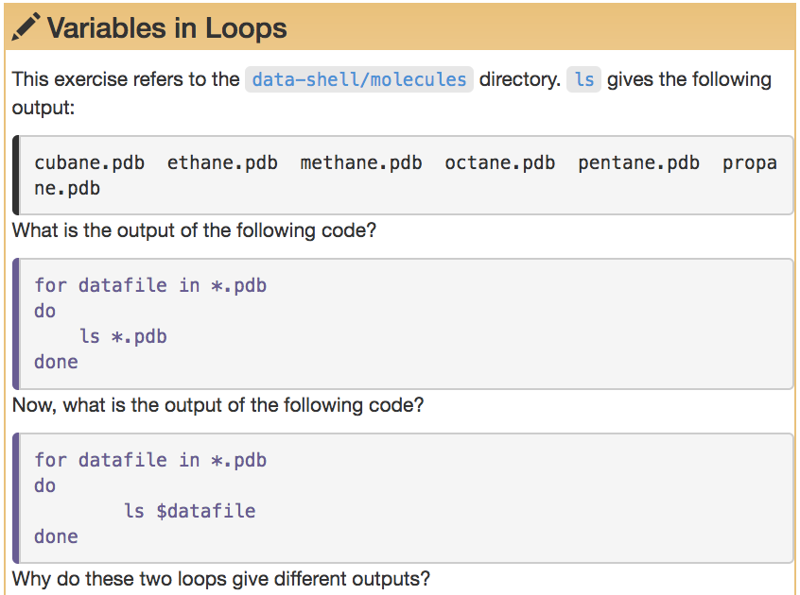
shell_data/molecules
Notes:
Try both to see how they look.
Go to molecules directory:
cd ../molecules
now run both loops

Slide 93
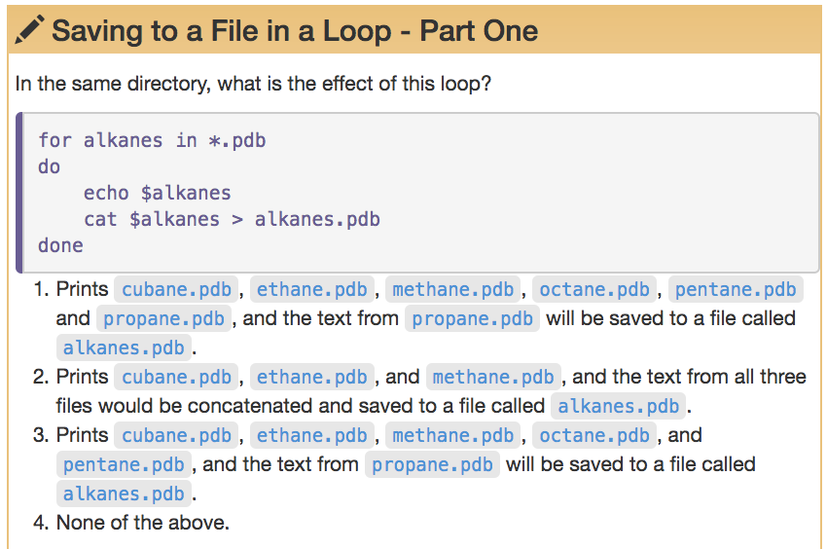

Slide 94
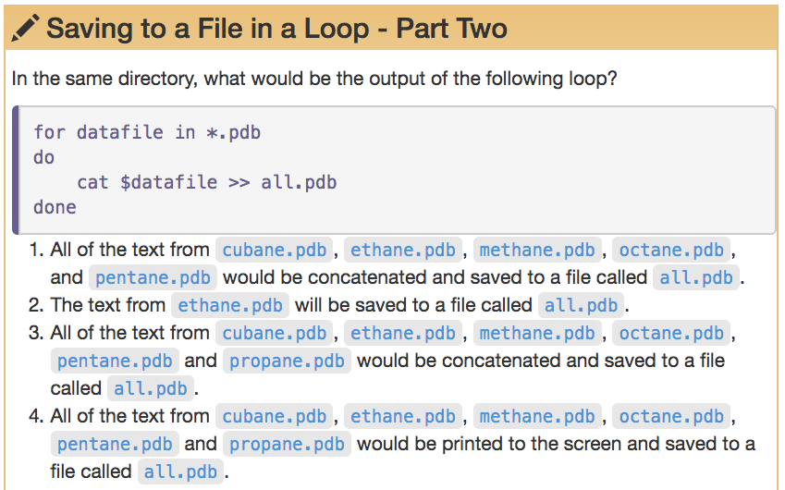

Slide 95
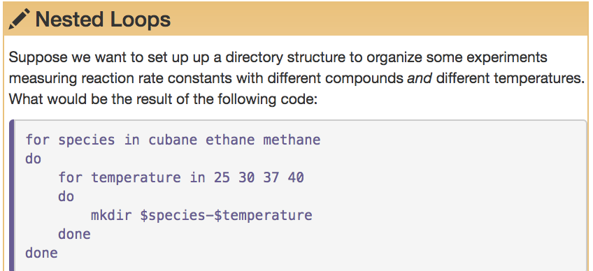
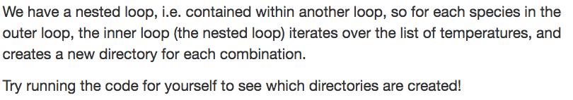

Slide 96
Using basename in for loops
Basename is a Unix feature that is really powerful when used in a for loop. It allows to access just the file prefix, which you can use to name things.
Let’s try this in the /creatures directory, by removing all the .txt extensions
Note: this does not change the files. It just creates variables without the file extensions
Notes:
Make sure you’re in the creatures directory:
cd ../creatures

Slide 97
Using basename in for loops
Basename is a Unix feature that is really powerful when used in a for loop. It allows to access just the file prefix, which you can use to name things.
Note: this does not change the files. It just creates variables without the file extensions
Let’s try this in the /creatures directory, by removing all the .txt extensions, then using the mv command, and adding the year to them
Notes:
Make sure you’re in the creatures directory:
cd ../creatures

Slide 98
Using basename in for loops
Notes:
Basename requires us to use the filename, then specify the part we want to remove (the .txt in this case)

Slide 100
Shell Scripts

Slide 101
text editor: nano
type “nano <filename>” this will open the named file for editing or create it if it doesn’t exist
type your text: the mouse will not move the cursor - navigate with the arrow keys
save and quit: commands are on the bottom of the screen - the “^” stands for “control”

Slide 102
text editor: vi/vim
On command line: “README.txt”
You land in command mode
To enter insert mode: “i” where the cursor is; “o” inserts one line below that
Navigate with arrow keys
To exit insert mode: “esc”
To save: “:w”
To exit: “:q”
To exit without saving: “q!”
Notes:
Lets’s start in the shell_data/untrimmed_fastq directory
vi README.txt
hit “i”
Type in some lines of text describing the files: what they contain, how many, location of backup files (if any). there’s not much to say about them right now, but in real life, we would update this readme file as we make edits.
When done, hit esc key, type :w, then :q

Slide 103
text editor: vi/vim
On command line: “README.txt”
You land in command mode
To enter insert mode: “i” where the cursor is; “o” inserts one line below that
Navigate with arrow keys
To exit insert mode: “esc”
To save: “:w”
To exit: “:q”
To exit without saving: “q!”
Lets’s start in the shell_data/untrimmed_fastq directory
vi bad-reads-script.sh
hit “i”
Type
grep -B1 -A2 NNNNNNNNNN *.fastq > scripted_bad_reads.txt
When done, hit esc key, type :w, then :q
Notes:
Lets’s start in the shell_data/untrimmed_fastq directory
vi bad-reads-script.sh
hit “i”
Type
grep -B1 -A2 NNNNNNNNNN *.fastq > scripted_bad_reads.txt
When done, hit esc key, type :w, then :q

Slide 104
Running the script in the shell
Now we can run the script in the shell: bash bad-reads-script.sh
It looks like nothing happened, but type at the prompt less scripted_bad_reads.txt and you’ll see the output

Slide 105
Making the script into a program
Running a script from bash is great, but you will want your scripts to run on their own. For this you need to change the permissions, as we mentioned earlier.
ls –l bad-reads-script.sh
chmod +x bad-reads-script.sh
The +x makes your program executable. Now you can run it without typing “bash”
./bad-reads-script.sh

Slide 106
More shell scripts,
with variables
If we want the user to select lines from a file of their choosing, we can use variables in our shell scripts
We use variables “$1”, “$2”, “$3”, etc for any data we want the user to input
We use quotes around the variables, in case there are spaces in filenames or the user’s entry
Let’s write a script to allow the user to select the middle lines from a file in the molecules directory
Notes:
cd ../molecules
vi middle.sh
i
# Select lines from the middle of a file.
# Usage: bash middle.sh filename end_line num_lines
head -n "$2" "$1" | tail -n "$3”
esc
:w :q
now run it:
bash middle.sh pentane.pdb 15 5

Slide 107
More shell scripts,
with variables
If we want the user to select lines from more than one file, we will need to use a variable that stands for any file
We use the variable “$@” to stand for any file that matches the user’s criteria, etc for any data we want the user to supply
Let’s write a script to allow the user to sort files by their length
Notes:
cd ..
vi sorted.sh
I
# Sort files by their length.
# Usage: bash sorted.sh one_or_more_filenames
wc -l "$@" | sort –n
esc
:w :q
now run it:
bash sorted.sh *.pdb ../untrimmed_fastq/*.fastq

Slide 108
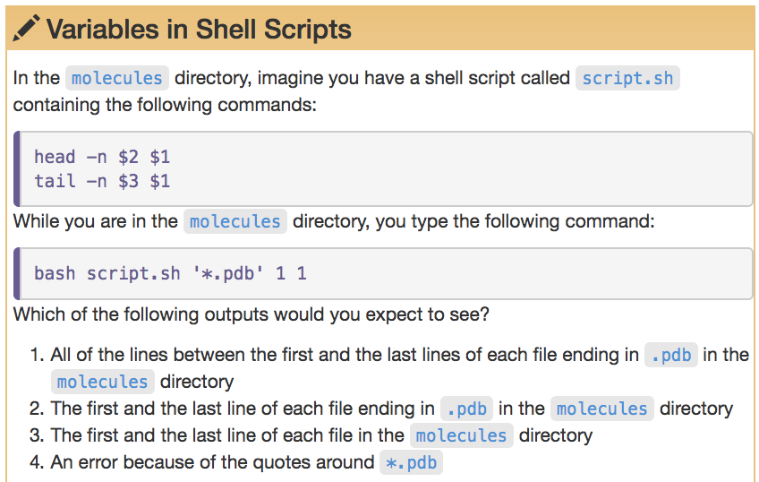

Slide 109
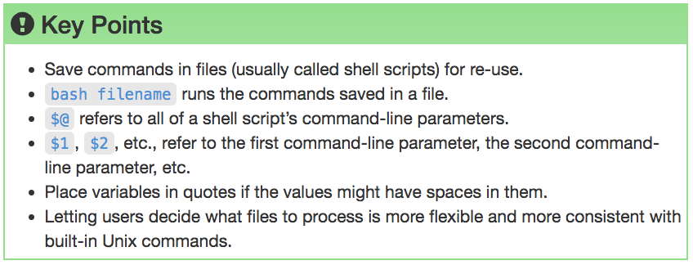

Slide 110
Want to learn (much) more?
Command Line Tools for Genomic Data Science Coursera course https://www.coursera.org/learn/genomic-tools
Free to take, offered frequently

Slide 111
Computational Skills for Informatics Workshop Series Galter Health Sciences Library
Intro to the Command Line
(with some genomics examples)
https://github.com/galterdatalab/commandline_genomics/
Pamela Shaw (Galter): p-shaw2@northwestern.edu
Slides courtesy of:
Janna Nugent: janna.nugent@northwestern.edu
With additional help from:
Dusan Ramljak dusan@northwestern.edu
Alper Kinaci: akinaci@northwestern.edu
Christina Maimone: christina.maimone@northwestern.edu

